Slide 2
Revisit and Review
Let’s practise reading some of this week’s focus words.
measure
closure
visual
Asia

Slide 3
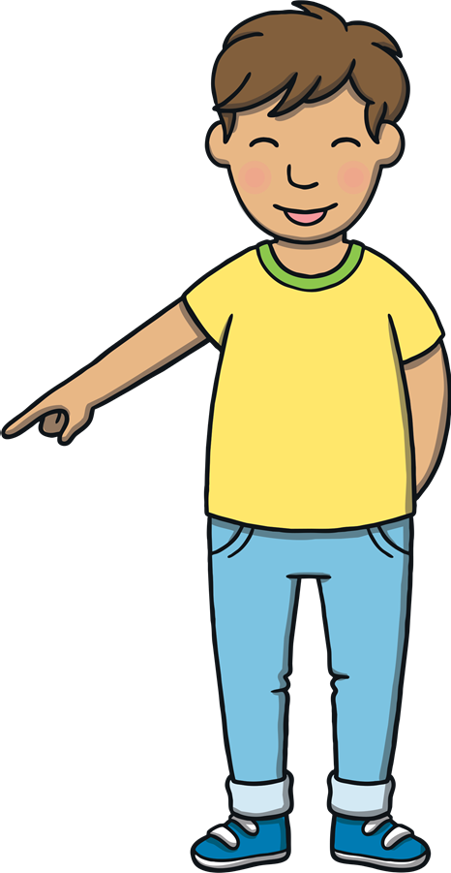
Teach
Now, let’s write them with the magic pencil…

Slide 4
Teach
measure
Play

Slide 5
Teach
Asia
Play

Slide 6
Teach
visual
Play

Slide 7
Teach
closure
Play

Slide 8
Teach
Today, we are learning to identify the different sounds that s can make.

Slide 9
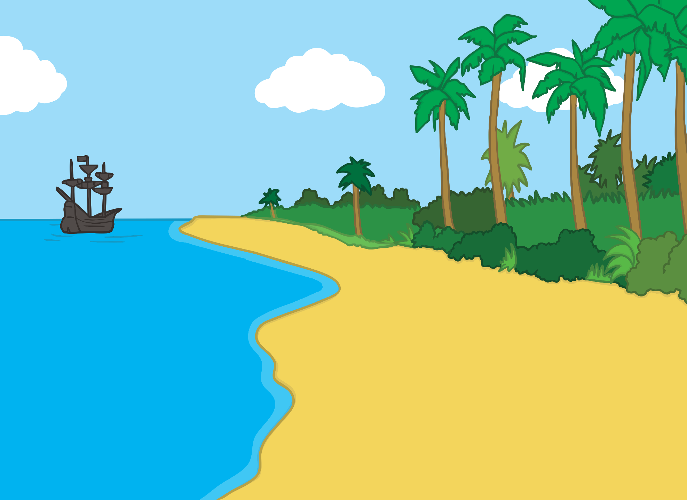
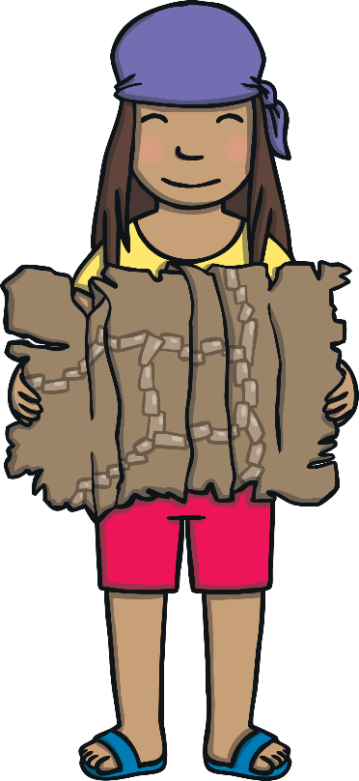
Teach
Kit and Sam were visiting their friend, Fran. They had worked together to fix an old treasure map from Fran’s grandfather. The map lead them to an island in Asia and they sailed off with glee.

Slide 10
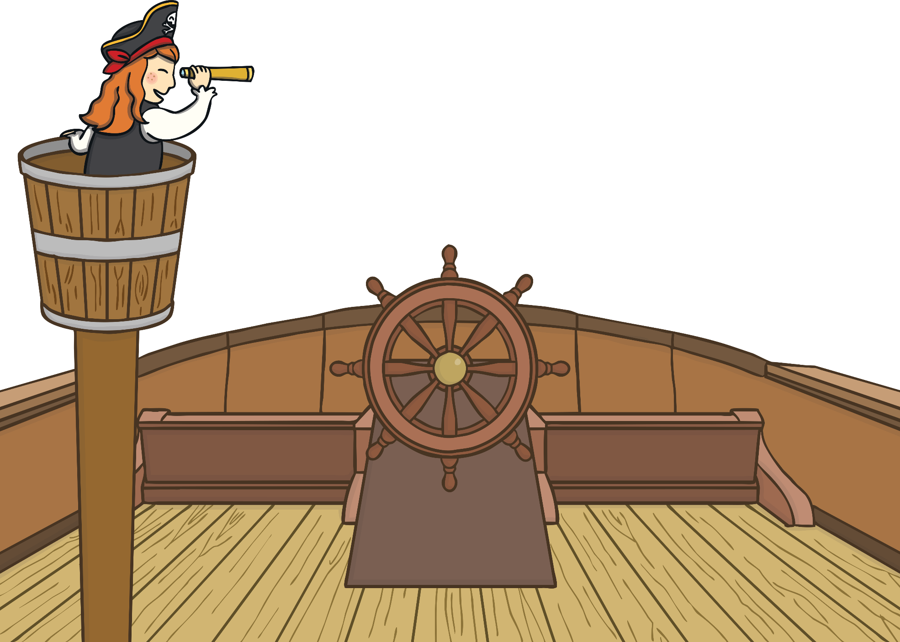
?
X
Teach
?
How do you think that Kit, Sam and Fran were feeling?
“We are off on a treasure hunt!” yelled Fran from the crow’s nest.
“Buried treasure, we are coming to get you!” shouted Sam.
“Asia, here we come!” boomed Kit in his best pirate voice.

Slide 11
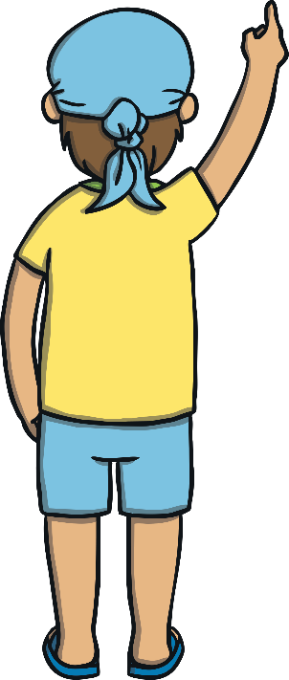
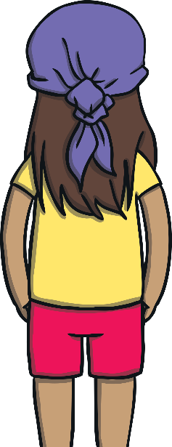
Teach
“Look!” cried Kit. “I can see dolphins!”
Fran and Sam ran over to Kit to watch the dolphins jump and splash beside the boat.
“They are so beautiful!” commented Sam.

Slide 12
Teach
When we see s in a word, it doesn’t always make the same sound. Look at these examples below.
What sound is the s making in these words?
treasure
- /zh/
sample
- /s/
sure
- /sh/

Slide 13
Teach
treasure
vision
treasure
television
version

Slide 14
Fishy Fun
Practise
Kit, Sam and Fran are feeding the dolphins!
Read the word on the fish and decide what sound the s makes in the word.
Feed the correct dolphin.

Slide 15
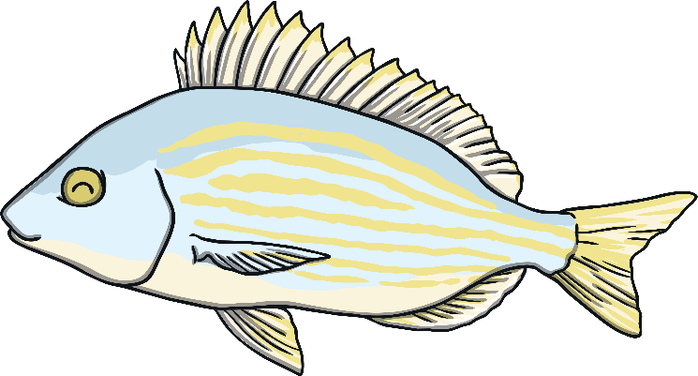
Practise
treasure
/zh/
/s/
/sh/

Slide 16
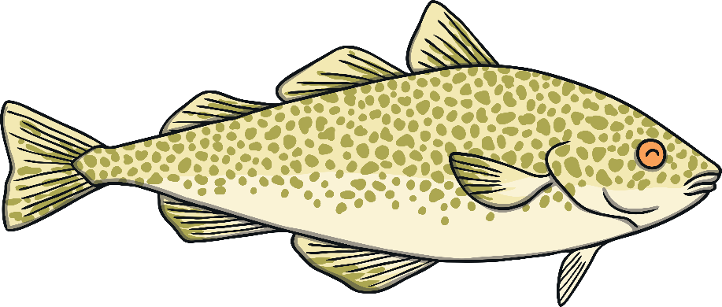
Practise
purse
/zh/
/s/
/sh/

Slide 17
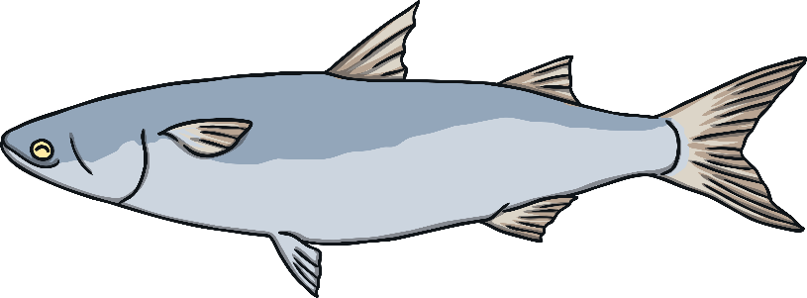
Practise
vision
/zh/
/s/
/sh/

Slide 18
Practise
sandpit
/zh/
/s/
/sh/

Slide 19
Practise
blister
/zh/
/s/
/sh/

Slide 20
Practise
clasp
/zh/
/s/
/sh/

Slide 21
Practise
television
/zh/
/s/
/sh/

Slide 22
Practise
mansion
/zh/
/s/
/sh/

Slide 23
?
X
Apply
?
How did Sam know some facts about dolphins?
“There are dolphins on the treasure map! We must be getting closer,” said Kit excitedly.
“I watched a programme about dolphins on the TV with Mum. They are very intelligent animals,” Sam commented to Fran.

Slide 24
Apply
“Dolphins are so interesting! I have been writing down what I have learnt about them in my notebook. Do you want to see?” asked Fran.
As Kit and Sam nodded, Fran ran to retrieve her notebook.

Slide 25
Dolphin Watch
Apply
Kit is reading Fran’s notes about the dolphins.
Listen carefully to the missing word in each sentence and write it down.
X
This is a great whiteboard activity.
Click me for Kit’s teaching tips!

Slide 26
Apply
A group of dolphins is called a pod.
Dolphins usually live in groups of around 12.
Dolphins show their pleasure by whistling.
A group of dolphins is called a pod.
Dolphins usually live in groups of around 12.
Dolphins show their pleasure by whistling.
Dolphins normally measure around 2.5 meters but it us not unusual to find dolphins measuring nearly 4 meters!
Dolphins normally measure around 2.5 meters but it us not unusual to find dolphins measuring nearly 4 meters!
Check

Slide 27
Apply
As the dolphins swam away, Kit looked closer at the treasure map. “We are beside Asia now. Leisure Cove, where the treasure is marked, is just in the distance. We are nearly there!” he bellowed.

Slide 28
Today, we have learnt…
s
saying /zh/
The adventure continues next lesson!

