Slide 1
Jake’s snow coat

Slide 2
Buy Jake’s snow coat today!
Getting cold halfway up a mountain is snow joke!

Slide 3
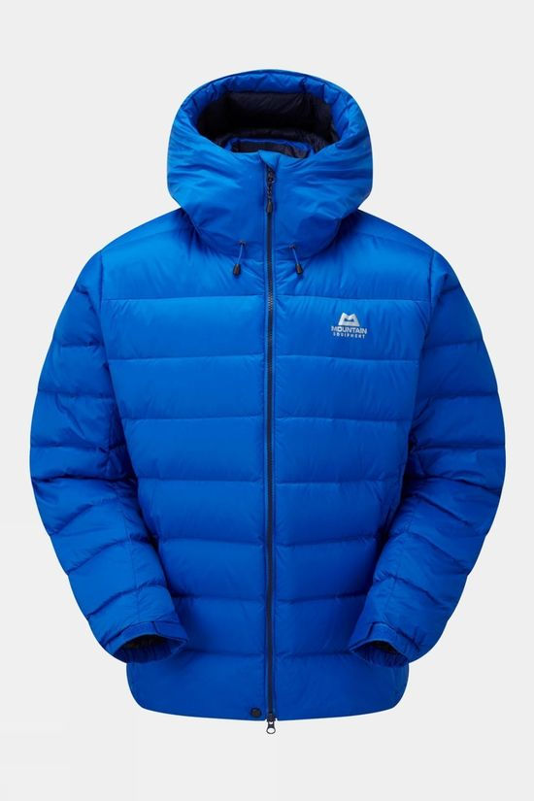
Need a tent? But don’t have a big enough bag? Or Want to glamp not camp? Want a simple answer? Then look no further! Buy Jake’s snow coat® today! Jake’s snow coat® has exclusive features, one of the best rated features is the infinite pocket!

Slide 4
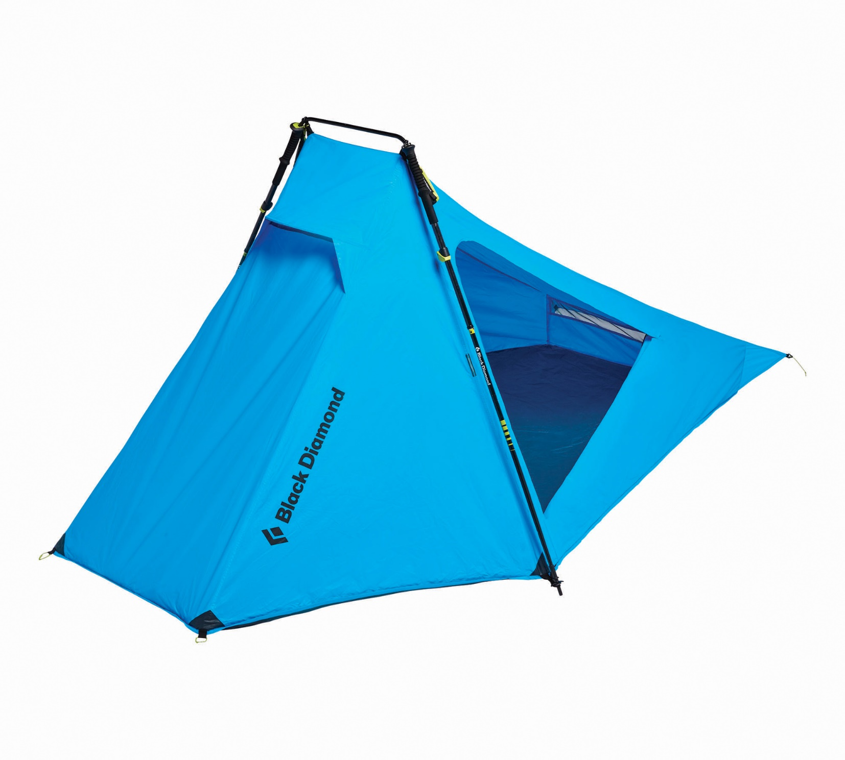
Infinite pocket
It is infinite!
It can fit anything in it!

Slide 5
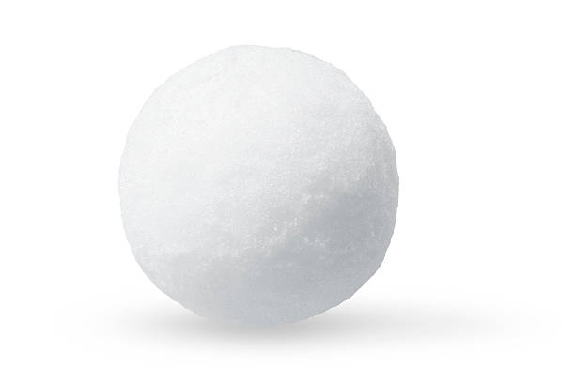
When Edmund Hillary featured in Retired mountaineers’ magazine, he rated Jake’s snow coat® five out of five snowballs!

Slide 6
Jake’s snow coat® is very reasonably priced at £99.99 which is almost too cheap for this amazing product.
Visit www.Jake’sSnowCoatIsLegendary.co.uk
Only £99.99

Slide 7
QUICK ONLY 10 LEFT IN STOCK BUY NOW!

