Slide 1
How does exercise effect our heart rate?

Slide 2
What do we think?

Slide 3
What are we measuring?

Slide 4
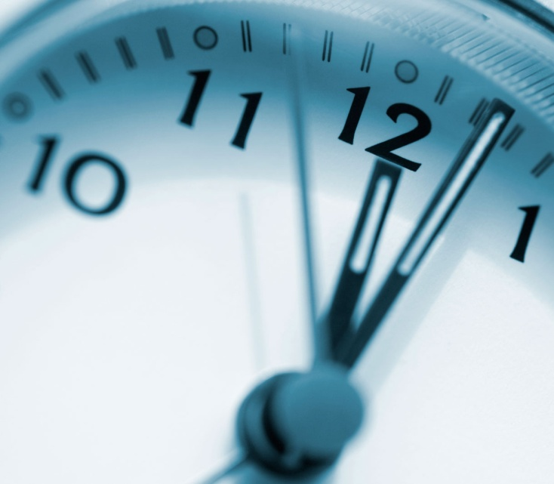
Our heart rate is the number of times our heart beats per minute.

Slide 5
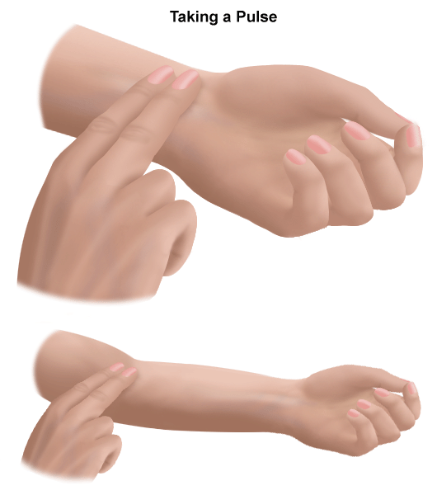
We’ll need to record our heart beats. How can we do this?

