Slide 1
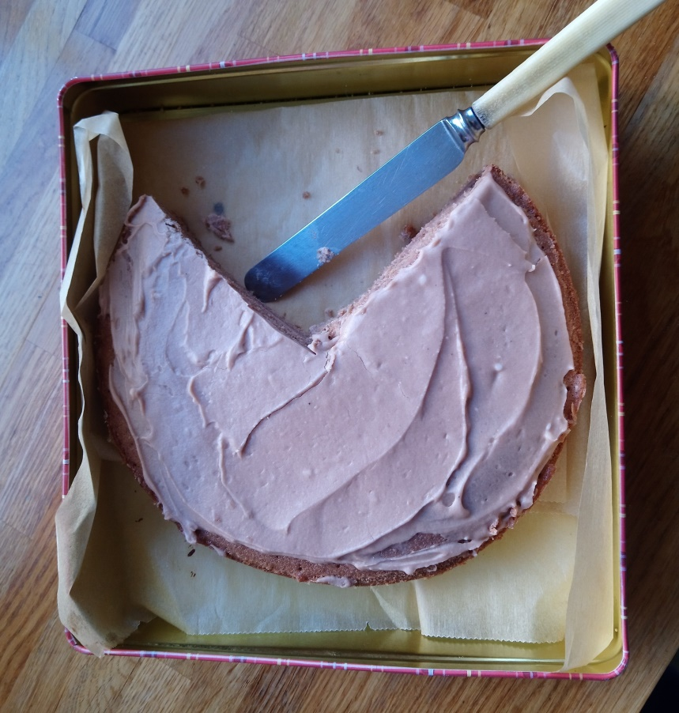
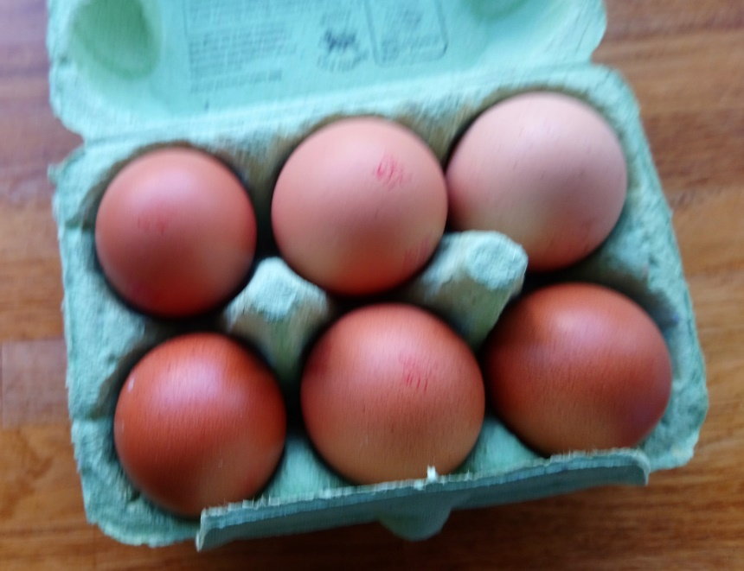
Fractions around the house.
¾ of the cake has not been eaten (will change).
6/6 eggs are in the carton
1/9 of the drawers can’t close

Slide 2
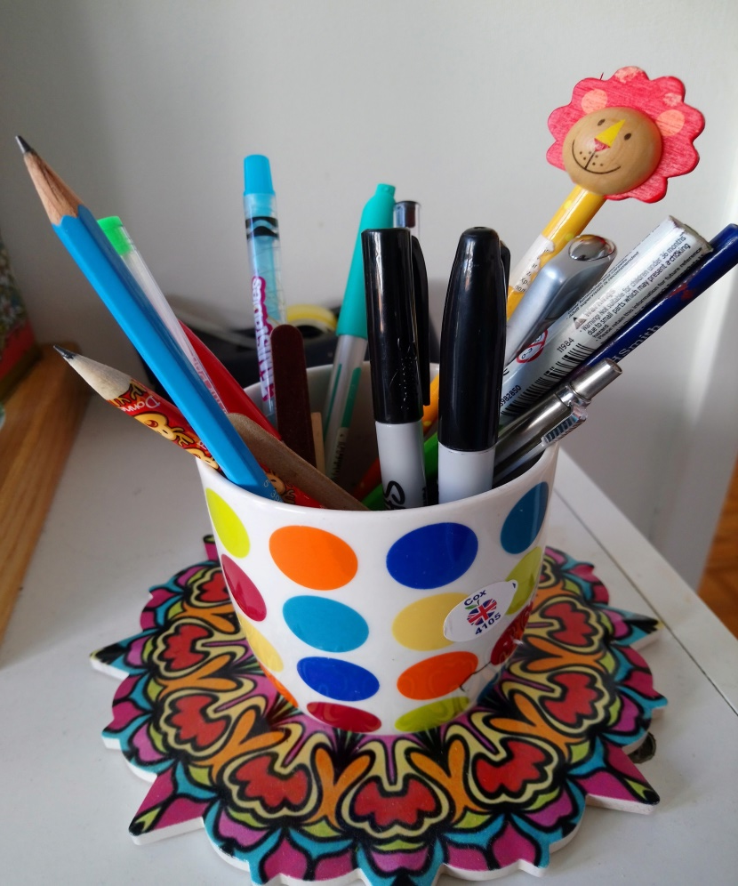
Continued…
1/3 of the buns are left.
2/15 of the pens are sharpies

Slide 3
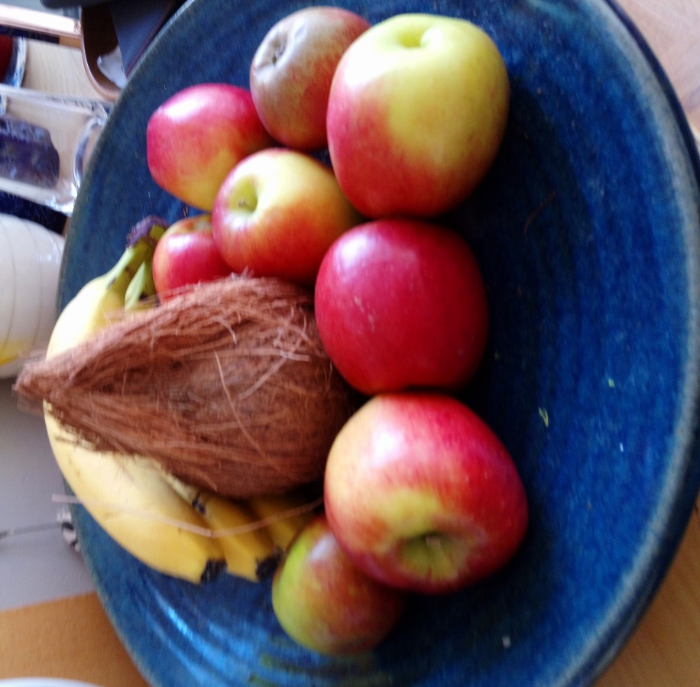
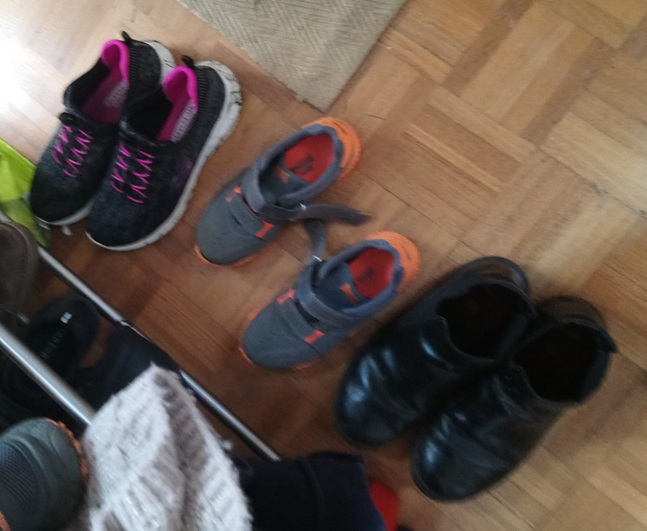
And more…
8/12 or 2/3 is apples
2/6 or 1/3 are grey
1/3 cushions has flowers on.

Slide 4
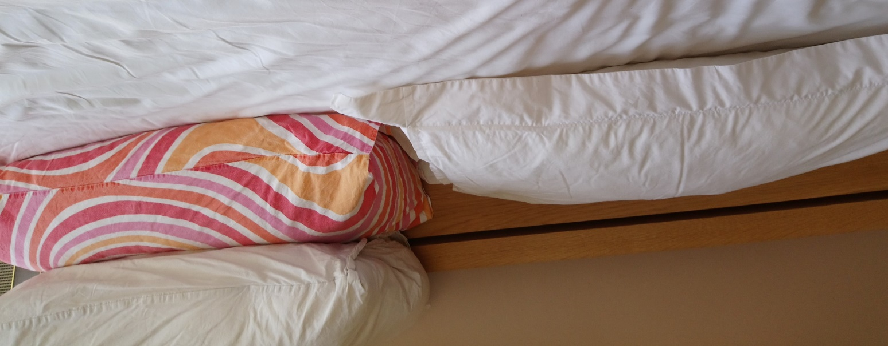
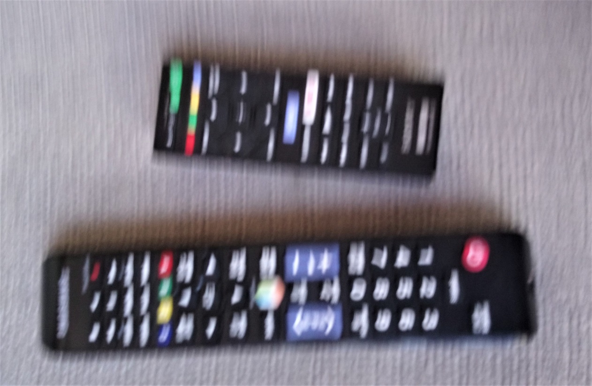
And finally.
1/3 of the pillows is stripey
1/3 of the lego containers is black
½ of the remote controllers is small.

Slide 5
The end (click on the link!)

